Slide 1











ONLINE SHOPPING
TEAM 16:
JENIN IMMANUEL
NALEN
JAYADHARSHINE
THRISHA
SHIVA SAKTHI

Slide 2
01
Contents
About our Project
Challenges
Structure
File Handling using Structures
Optional Features

Slide 3
02
About Our Project
Online shopping is the process whereby consumers directly buy goods or services from a seller in real-time, without an intermediary service, over the Internet. It is a form of electronic commerce. An online shop, eshop, e-store, Internet shop, webshop, webstore, online store or virtual store evokes the physical analogy of buying products or services.

Slide 4
03
Challenges
Creating a super user/ supplier
Tracking Products
Maintaining immediate stock updates

Slide 5
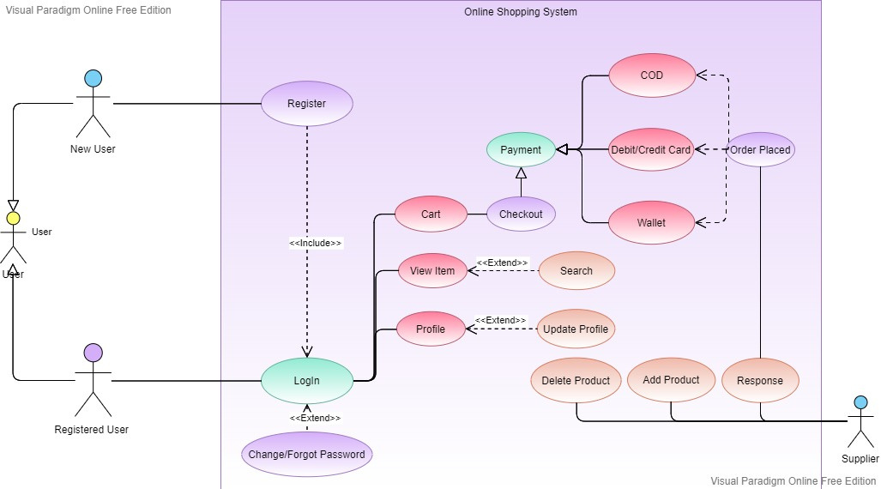
04
Structure

Slide 6
05
File Handling
For writing in file, it is easy to write string or int to file using fprintf and putc, but you might have faced difficulty when writing contents of struct.
fwrite and fread make task easier when you want to write and read blocks of data.
Syntax (fwrite): fwrite(const void *ptr, size_t size, size_t nmemb, FILE *stream)
Syntax (fread): fread(const void *ptr, size_t size, size_t nmemb, FILE *stream)

Slide 7
06
Optional Features
OTP for verification
Mailing features for orders
Super user management facilities

Slide 8
Thank
you!

